Slide 1


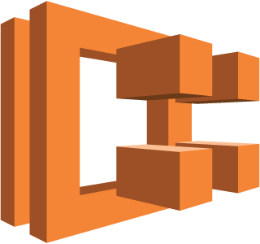

Application Load Balancer
/
(path)
80
80
Task/Container
Task/Container
Virtual Private Cloud

